Slide 1
Janus Solar and Battery Storage Project Draft Environmental Impact Report
Agenda Item:
Presentation on the Janus Solar and Battery Storage project's Draft Environmental Impact Report (DEIR)(SCH #2024061043)
Purpose:
Receive any public verbal comments
Receive any Commission verbal comments or questions
Janus Solar PV, LLC submitted a new Conditional Use Permit application for a solar photovoltaic (PV) power generating facility.
Generate up to 80 megawatts of electricity and store up to 320 megawatt hours (MWh) of electricity on an approx. 886-acre site; only an estimated 666 acres of the site would be used.

Slide 2
Janus Solar and Battery Storage Project - Draft Environmental Impact Report - 2 -
Overview:
An Environmental Impact Report (EIR) is being processed to analyze the potential impacts of the proposed project.
NOC of the Draft EIR has been published and State agencies and public review period ends on November 13, 2024.
Purpose of bringing the DEIR to the Commission during review period, is to allow the Commission to receive and provide verbal comments on the Draft EIR.
All comments received would be included in the Final EIR.
The FEIR and Use Permit and Development Agreement would be processed before the Planning Commission for a recommendation to the Board.
The Board of Supervisors would then make a final decision on the FEIR, UP and DA along with a determination of Williamson Act compatibility.

Slide 3
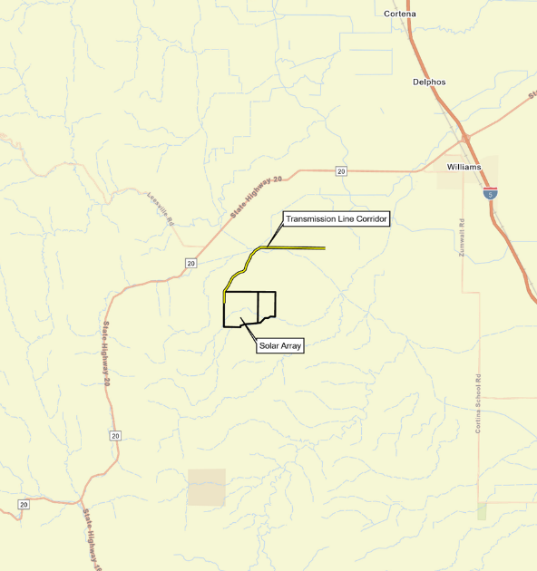
Janus Solar and Battery Storage Project - Draft Environmental Impact Report - 3 -
Location:
Approximately 6.5 west/southwest from the City of Williams.
Approximately 1.64 miles to the south of the Spring Valley Road/Walnut Drive street intersection.

Slide 4
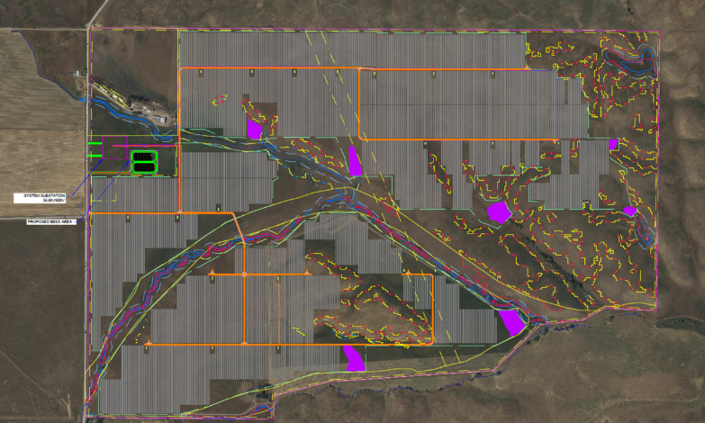
Janus Solar and Battery Storage Project - Draft Environmental Impact Report - 4 -
Location:
An estimated 666 acres of the 886-acre site would be used for the project. Environmentally sensitive areas would be avoided.

Slide 5
Janus Solar and Battery Storage Project - Draft Environmental Impact Report - 5 -
Location:
Project Includes – Approximately 196,000 Solar Panels
Solar Panels
Solar Panels
Solar Panels
Solar Panels

Slide 6
Janus Solar and Battery Storage Project - Draft Environmental Impact Report - 6 -
Location:
Project Includes – An On-Site Substation (approx. 3 acres)
On-Site
Substation
Solar Panels
Solar Panels
Solar Panels
Solar Panels

Slide 7
Janus Solar and Battery Storage Project - Draft Environmental Impact Report - 7 -
Location:
Project Includes – Battery Energy Storage System (approx. 4 acres)
BESS
Solar Panels
On-Site Substation
Solar Panels
Solar Panels
Solar Panels

Slide 8
Janus Solar and Battery Storage Project - Draft Environmental Impact Report - 8 -
Overview:
Planning Commission will make a recommendation to the Board
FEIR
Use Permit
Development Agreement.
Board of Supervisors will make final decision along with a determination of Williamson Act compatibility.

Slide 9
Janus Solar and Battery Storage Project - Draft Environmental Impact Report - 9 -
CEQA:
Staff reviewed the application, determined that the project could have potential significant impacts.
Triggered the preparation of a Environmental Impact Report
Purpose of an EIR is to document the potential direct, indirect, and cumulative impacts of the proposed project.
EIR is primarily an informational document intended to inform the public, decision-makers, and other responsible agencies of the potentially significant effects of a proposed project.
In addition, an EIR identifies feasible mitigation measures and reasonable alternatives to reduce significant impacts.
The decision-making bodies then must consider the FEIR before taking action on the proposed project.

Slide 10
Janus Solar and Battery Storage Project - Draft Environmental Impact Report - 10 -
CEQA:
EIR prepared in two key stages.
First, DEIR is prepared and distributed for review and comment.
Once comments on the DEIR are received, responses to those comments and any additional analysis is prepared.
Second, the comments, responses to and the DEIR comprise the FEIR.
The FEIR is used by the decision making bodies to determine the environmental impacts of proposed project to make an informed decision.
With this application, the Planning Commission will be making a recommendation on the FEIR and the project to the Board of Supervisors.
The Board will be making the final decision.

Slide 11
Janus Solar and Battery Storage Project - Draft Environmental Impact Report - 11 -
Project Approval Process:
Under the typical process, the Planning Commission is the approval authority for a Use Permit (Zoning Code Table 44-1.70-1)
However, the project includes a Development Agreement
Commission makes a recommendation on the Development Agreement
The Board of Supervisors make the final decision
When multiple applications are being processed, the final action for all permits is acted upon by the highest authority (Zoning Code §44-1.70.020(d).
Application involves a Use Permit and Development Agreement
Board is the highest review authority
Planning Commission recommends a decision on UP and DA and the Board makes final decision.

Slide 12
Janus Solar and Battery Storage Project - Draft Environmental Impact Report - 12 -
DEIR Review:
Project’s DEIR analyzed 20 different environmental issues.
Staff report contains a brief summary of each issue.
This presentation will focus on several issues where there have been project changes or new information from the last project.
Section 4.1 Aesthetics Section 4.2 Agriculture and Forestry Resources Section 4.3 Air Quality Section 4.4 Biological Resources Section 4.5 Cultural Resources Section 4.6 Energy Section 4.7 Geology, Soils, and Paleontological Resources Section 4.8 Greenhouse Gases Section 4.9 Hazards and Hazardous Materials Section 4.10 Hydrology and Water Quality | Section 4.11 Land Use and Planning Section 4.12 Mineral Resources Section 4.13 Noise Section 4.14 Population and Section 4.15 Public Services Section 4.16 Recreation Section 4.17 Transportation Section 4.18 Tribal Cultural Resources Section 4.19 Utilities Section 4.20 Wildfire

Slide 13
Janus Solar and Battery Storage Project - Draft Environmental Impact Report - 13 -
DEIR Review:
Section 4.1 Aesthetics
A Visual Impact Assessment was performed and is included as Appendix B.
Assessment based on the Contrast Rating System used by the U.S. Bureau of Land Management (BLM) to objectively measure visual change.
The significance criteria used is contained in Appendix G of the CEQA Guidelines and determine impacts to existing visual resources.
Eight Key Observation Points were selected to assess the level of visual change.
The KOPs representative views from Walnut Drive, Spring Valley Road, and residences north and south of the project.

Slide 14
Janus Solar and Battery Storage Project - Draft Environmental Impact Report - 14 -
DEIR Review:
Walnut Drive 3 views
Spring Valley Road 3 views
Northern Residence 1 view
Southern Residence 1 view

Slide 15
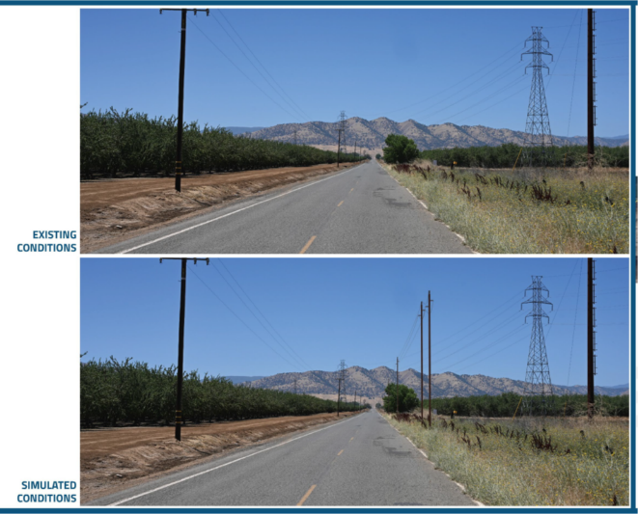
Janus Solar and Battery Storage Project - Draft Environmental Impact Report - 15 -
DEIR Review:
Walnut Drive View 1

Slide 16
Janus Solar and Battery Storage Project - Draft Environmental Impact Report - 16 -
DEIR Review:
Walnut Drive View 2

Slide 17
Janus Solar and Battery Storage Project - Draft Environmental Impact Report - 17 -
DEIR Review:
Walnut Drive View 3

Slide 18
Janus Solar and Battery Storage Project - Draft Environmental Impact Report - 18 -
DEIR Review:
Spring Valley Road View 1

Slide 19
Janus Solar and Battery Storage Project - Draft Environmental Impact Report - 19 -
DEIR Review:
Spring Valley Road View 2

Slide 20
Janus Solar and Battery Storage Project - Draft Environmental Impact Report - 20 -
DEIR Review:
Spring Valley Road View 3

Slide 21
Janus Solar and Battery Storage Project - Draft Environmental Impact Report - 21 -
DEIR Review:
Northern Residence View 1

Slide 22
Janus Solar and Battery Storage Project - Draft Environmental Impact Report - 22 -
DEIR Review:
Southern Residence View 1 (not directly in front of residence at corner due to existing vegetation)

Slide 23
Janus Solar and Battery Storage Project - Draft Environmental Impact Report - 23 -
DEIR Review:
Section 4.1 Aesthetics Impact Finding:
Overall, the DEIR found that
There were no potential visual impacts
Or that the potential visual impacts were less than significant

Slide 24
Janus Solar and Battery Storage Project - Draft Environmental Impact Report - 24 -
DEIR Review:
Section 4.9 Hazards and Hazardous Materials
Analyzed the potential hazards and hazardous materials used during construction and in operation.
Focused on two particular issues:
Solar Photovoltaic Panels
Battery Energy Storage System (BESS)
Solar Photovoltaic Panels
Anticipated solar panels would be made from polycrystalline silicon or thin-film technology.

Slide 25
Janus Solar and Battery Storage Project - Draft Environmental Impact Report - 25 -
DEIR Review:
Solar Photovoltaic Panels
Crystalline silicon PV panels may include small amounts of materials considered to be hazardous.
These materials are in a solid and nonleachable state.
Broken crystalline silicon PV panels would not be a source of pollution to surface water, stormwater, or groundwater.
In a fire, no emissions would be released because the materials would dissolve into the molten glass (assuming the heat would be sufficient to melt the glass).

Slide 26
Janus Solar and Battery Storage Project - Draft Environmental Impact Report - 26 -
DEIR Review:
Battery Energy Storage System (BESS)
Lithium-ion technology, with lithium iron phosphate (LFP) sub-chemistry, is proposed for the BESS.
The LFP technology includes enhanced fire-preventative design and stable chemical composition.
The proposed battery technology also complies with Underwriters Laboratories (UL; safety organization) 9540A testing.
UL 9540A testing confirms thermal runaway and fire risks are mitigated.

Slide 27
Janus Solar and Battery Storage Project - Draft Environmental Impact Report - 27 -
DEIR Review:
The BESS has multi-tiered safety and accident prevention systems.
Located more than 500 feet from Spring Valley Road to ensure that any emergency response would not block Spring Valley Road.
BESS has obtained a third-party Hazard Mitigation Analysis (App “G”)
Thermal runaway condition;
Failure of an energy storage management system;
Failure of a required ventilation or exhaust system;
Failure of a required smoke detection, fire detection, fire suppression, or gas detection system;
Voltage surges on the primary electric supply; and
Short circuits.

Slide 28
Janus Solar and Battery Storage Project - Draft Environmental Impact Report - 28 -
DEIR Review:
As detailed in the Hazard Mitigation Analysis, under all circumstances, the proposed BESS’s protection systems effectively managed all fault conditions.
Noted Features
Multiple individual compartments = single BESS container. Additional layer of protection by isolating individual enclosures - avoids propagation across the system.
Each module own Battery Management System (BMS).
24/7 remote monitoring and diagnostics
Early detection
Automatically shut down modules.

Slide 29
Janus Solar and Battery Storage Project - Draft Environmental Impact Report - 29 -
DEIR Review:
Temperature, gas, and smoke monitoring
Very Early Smoke Detection Apparatus (VESDA) that continuously samples air to detect potential fire hazard before there is visible smoke
BESS units have undergone destructive unit-level tests
Under all circumstances analyzed, the BESS systems effectively managed all potential fault conditions.
Example 1: UL 9540A certification worst-case scenario (i.e., 100% charged with Battery Management System (BMS) and Thermal Management System (TMS) disabled).
Six cells of battery module were forced into a thermal runaway.

Slide 30
Janus Solar and Battery Storage Project - Draft Environmental Impact Report - 30 -
DEIR Review:
Results:
Thermal runaway propagated to a seventh cell, but did not propagate any further and no propagation to adjacent battery modules occured.
No flames outside were observed.
Internal temperatures were below venting triggers.
Explosion hazards, observations of a projectiles, flying debris, detonation, or other explosive discharge of gases were not observed.
Toxic gases at 20 feet from BESS are a fraction of levels that are considered dangerous.

Slide 31
Janus Solar and Battery Storage Project - Draft Environmental Impact Report - 31 -
DEIR Review:
Example 2: UL 9540A certification worst-case scenario (i.e., 100% charged with Battery Management System (BMS) and Thermal Management System (TMS) disabled).
More aggressive approach then required by UL 9540A certification.
Forty-eight (48) cells within a module were forced into a thermal runaway.
Results:
Thermal runaway propagated to all the cells in the initiating tray.
Maximum flame heights were 2.5 ft above the top of the BESS.
Fire spread was slow and only visible for 6 hours and 40 minutes.

Slide 32
Janus Solar and Battery Storage Project - Draft Environmental Impact Report - 32 -
DEIR Review:
Fire stopped at the half-way point of the cabinet.
Internal vents opened.
Cabinet doors adjacent to the initiating battery module remained closed.
No hazardous pressure waves, debris, shrapnel, or pieces of the cabinet were ejected.
Toxic gases at 20 feet from BESS remained at a fraction of levels that are considered dangerous.

Slide 33
Janus Solar and Battery Storage Project - Draft Environmental Impact Report - 33 -
DEIR Review:
Section 4.9 Hazards and Hazardous Materials Findings:
Overall, the DEIR found that:
There were no potential Hazards and Hazardous Materials impacts
That potential Hazards and Hazardous Materials impacts were less than significant
Or that potential Hazards and Hazardous Materials impacts were less than significant with Mitigation Measure FIRE-1
Significant reason for this determination was the cabinet design itself and the multiple safeguards and protection systems.

Slide 34
Janus Solar and Battery Storage Project - Draft Environmental Impact Report - 34 -
DEIR Review:
Section 4.9 Wildfire:
DEIR modeled a potential wildfire without the project.
The DEIR found a pre-development wildfire would result in:
Flame lengths ranging from 12-15 feet
Rates of spread would range from 3.0-5.1 mph
Spotting distances up to 0.5-0.6 miles
DEIR modeled a potential wildfire with the project.
The modeling identified 3 modified zones for the project

Slide 35
Janus Solar and Battery Storage Project - Draft Environmental Impact Report - 35 -
DEIR Review:
Vegetation Management Zones
Fuel Modification Zone 1: Gravel, paved, or barren land
0-30 feet from BESS, substation, and roads.
Free of vegetation and all combustible materials
Fuel Modification Zone 2: Grass mowed to stubble height (~2 inches)
0-20 feet from the project’s perimeter
Fuel Modification Zone 3: Grass mowed to height of 4 inches
0-20 feet from all PV arrays, 30-100 feet from BESS and Substation
Grassland in other areas would be maintained at 12” max. height.
No vegetation management within Crotch’s bumble bee avoidance areas.

Slide 36
Janus Solar and Battery Storage Project - Draft Environmental Impact Report - 36 -
DEIR Review:
Grass 12” Max. Height
Avoidance Area

Slide 37
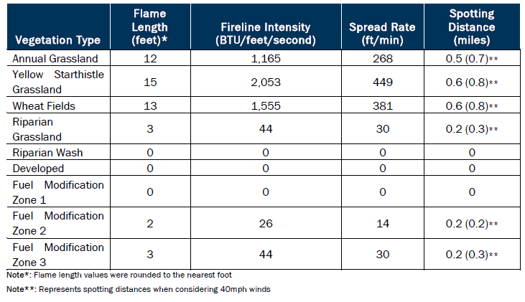
Janus Solar and Battery Storage Project - Draft Environmental Impact Report - 37 -
DEIR Review:
Section 4.9 Wildfire: Table 4, FIRE HAZARD ANALYSIS TECHNICAL MEMORANDUM

Slide 38
Janus Solar and Battery Storage Project - Draft Environmental Impact Report - 38 -
DEIR Review:
Section 4.9 Wildfire:
Overall, the DEIR found that:
That potential Wildfire Hazard impacts were less than significant
Or that potential Wildfire Hazard impacts were less than significant with Mitigation Measure FIRE-1

Slide 39
Janus Solar and Battery Storage Project - Draft Environmental Impact Report - 39 -
DEIR Review:
As previously mentioned, the DEIR analyzed 20 different environmental issues.
Staff report contains a brief summary of each issue.
Section 4.1 Aesthetics Section 4.2 Agriculture and Forestry Resources Section 4.3 Air Quality Section 4.4 Biological Resources Section 4.5 Cultural Resources Section 4.6 Energy Section 4.7 Geology, Soils, and Paleontological Resources Section 4.8 Greenhouse Gases Section 4.9 Hazards and Hazardous Materials Section 4.10 Hydrology and Water Quality | Section 4.11 Land Use and Planning Section 4.12 Mineral Resources Section 4.13 Noise Section 4.14 Population and Section 4.15 Public Services Section 4.16 Recreation Section 4.17 Transportation Section 4.18 Tribal Cultural Resources Section 4.19 Utilities Section 4.20 Wildfire

Slide 40
Janus Solar and Battery Storage Project - Draft Environmental Impact Report - 40 -
DEIR Review:
This presentation focused:
On issues that have been of heightened concern in the past.
And changed circumstances or new information is available
DEIR Comment Period
DEIR Comment Period Ends on November 13th.
The FEIR will respond to all verbal and written comments

Slide 41
Janus Solar and Battery Storage Project - Draft Environmental Impact Report - 41 -
DEIR Review:
Introduction to Alternatives: CEQA requires that an DEIR describe a range of alternatives which could feasibly avoid or lessen any significant environmental impacts.
Chapter 3 of the DEIR
Describes potential alternatives that were considered and eliminated from consideration.
Key provisions to consider Alternatives
Focus on alternatives that avoids/substantially lessen significant impacts
Even if project objectives would not be fully met or be more costly
The “No Project Alternative” is required to be considered.

Slide 42
Janus Solar and Battery Storage Project - Draft Environmental Impact Report - 42 -
DEIR Review:
Alternatives governed by a “rule of reason”
Only those alternatives necessary to permit a reasoned choice
Not every conceivable alternative to a project
For alternative locations, only locations that would avoid or substantially lessen significant impacts of the proposed project
Does not need to consider an alternative where effects cannot be reasonably ascertained
Or implementation is remote and is speculative

Slide 43
Janus Solar and Battery Storage Project - Draft Environmental Impact Report - 43 -
DEIR Review:
Alternatives Considered
No Project Alternative (mandatory)
Distributed, rooftop solar throughout Colusa County
A solar PV only (BESS component removed)
Undergrounding the gen-tie line
Off-site alternative in northeastern Colusa County

Slide 44
Janus Solar and Battery Storage Project - Draft Environmental Impact Report - 44 -
DEIR Review:
Alternatives Eliminated
Reduced Acreage Alternative
Orchard Alternative
Conservation and Demand Side Management Alternative.

Slide 45
Janus Solar and Battery Storage Project - Draft Environmental Impact Report - 45 -
DEIR Review:
Summary
A DEIR has been prepared for the Janus Solar and Battery Storage project.
The DEIR is currently in the public review and comment period.
Comment Period Ends on November 13, 2024
Purpose of Planning Commission meeting
Provide the community with an opportunity to submit verbal comments.
Meeting also provide an opportunity for the Planning Commission to provide comments as well!

Slide 46
Janus Solar and Battery Storage Project - Draft Environmental Impact Report - 46 -
DEIR Review:
Summary
Note the purpose of the meeting is NOT to:
To address or answer questions or
Make any project related decisions
Responses to questions and conducting further analysis to address issues/concerns raised will be provided in through the Final EIR
The FEIR will be subsequently prepared and brought back to the Planning Commission with the proposed Use Permit and Development Agreement at a subsequent Planning Commission meeting.

Slide 47
Janus Solar and Battery Storage Project - Draft Environmental Impact Report - 47 -
DEIR Review:
Recommendations
Ask any questions of staff
Receive presentation from the applicant and their technical experts
Additional BESS technical information
Additional wildfire technical information
Receive any verbal comments from the public
Finally, the Commission should provide any comments/questions to be included in the FEIR

